Slide 1
Pixelated Image Detection & Correction
Pixelated images are digital images that have been compressed or distorted, resulting in a blocky, low-resolution appearance. This visual effect can be intentionally used for artistic or practical purposes, but it can also occur due to technical limitations or poor image processing

Slide 2
Unique idea brief (solution)
An solution that can detect pixelated images
If image is pixelated then it go under anther algorithm for correction
The process begins by sharpening the image using the unsharp masking technique, which enhances edges and details. Initially, the image undergoes Gaussian blurring with a 21x21 pixel kernel size, creating a smoother version.
Subsequently, the original image is combined with the blurred one using cv2.addWeighted, adjusting weights to enhance edges and details effectively, resulting in a sharpened output

Slide 3
Unique idea brief(Continue)
Following sharpening, the sharpened image undergoes denoising using cv2.fastNlMeansDenoisingColored. This technique reduces noise while preserving image details by employing parameters like filter strengths for luminance and chrominance (set at 10 each), a template patch size of 7, and a search window size of 21.
Finally, a median blur operation is applied using cv2.medianBlur with a 5-pixel kernel size. This non-linear filter replaces each pixel with the median value of its neighbourhood, further reducing noise and refining the image for smoother visual output.
These combined steps ensure the image is sharpened, noise is effectively minimized, and the final quality is optimized for various applications.

Slide 4
Features offered
Image Sharpening: Applies unsharp masking by first blurring the image with Gaussian blur and then combining it with the original using weighted addition. This enhances edges and details.
Image Denoising: Uses non-local means denoising on the sharpened image to reduce noise while preserving image quality. Parameters like filter strengths, template patch size, and search window size are adjustable.
Noise Reduction with Median Blur: Applies median blur to further reduce noise in the image. This step helps in smoothing out remaining noise artefacts. Error Handling and Feedback: Provides error messages if the image fails to load and prints confirmation upon successful saving of the final image.

Slide 5
Process Flow (Step:1)
Pixelation Detection :The algorithm analyzes the image and identifies the pixelated regions.
Image Loading and Checking: Reads an image from a specified file path using cv2.imread.Checks if the image was successfully loaded. If not, it prints an error message and exits

Slide 6
Step: 2
Image Sharpening:
•Gaussian Blur: Applies Gaussian blur with a kernel size of 21x21 pixels to create a smoothed version of the image.
•Unsharp Masking: Combines the original image with the blurred image using cv2.addWeighted. Adjusts weights (1.5 for the original image and -0.5 for the blurred image) to enhance edges and details, producing a sharpened image.

Slide 7
Step:3
Image Denoising: Applies non-local means denoising to the sharpened image.
Configures denoising parameters :Strength parameters for luminance and chrominance denoising (both set to 10).
1)Template patches size of 7x7 pixels.
2)Search window size of 21x21 pixels.

Slide 8
Step:4
Saving the Final Image: Saves the final processed image to a specified output path using cv2.imwrite.
Optional Image Display : Waits for a key press (cv2.waitKey(0)) before closing all display windows

Slide 9
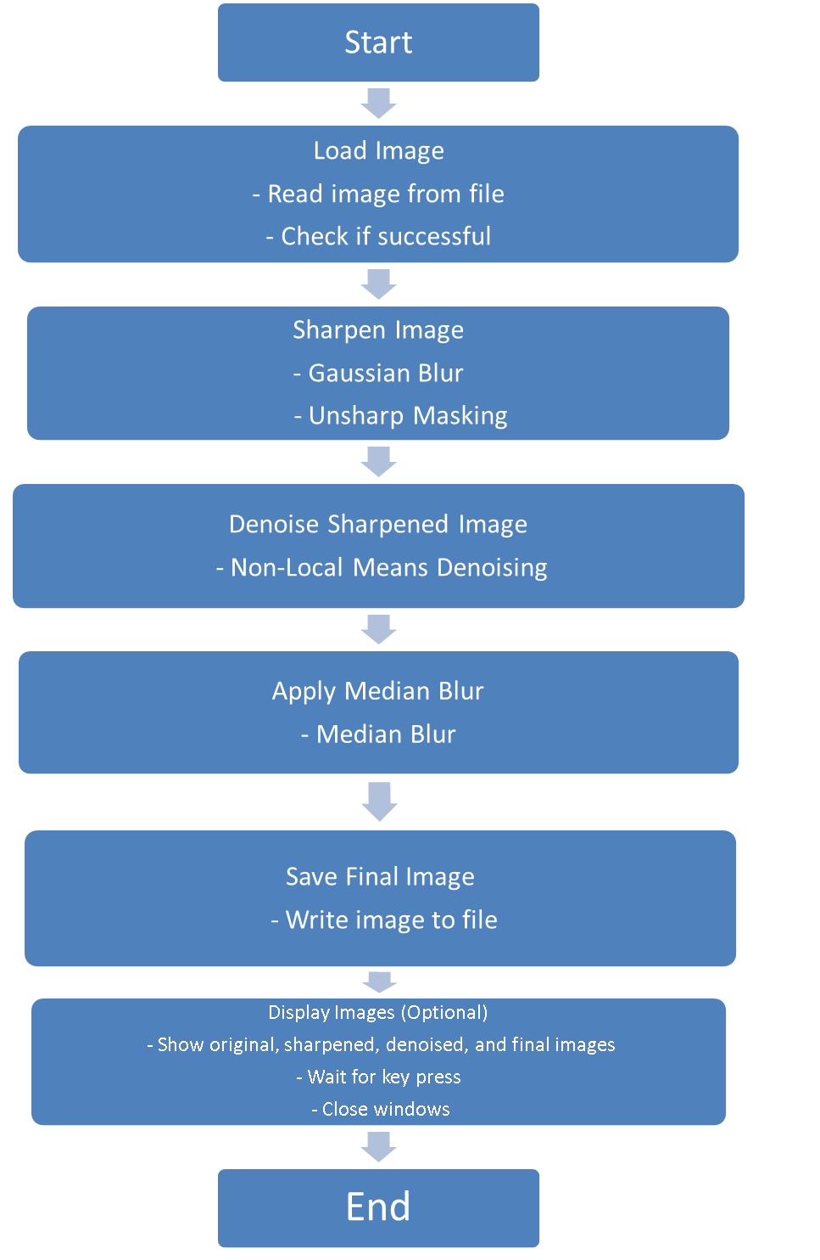
Architecture Diagram

Slide 10
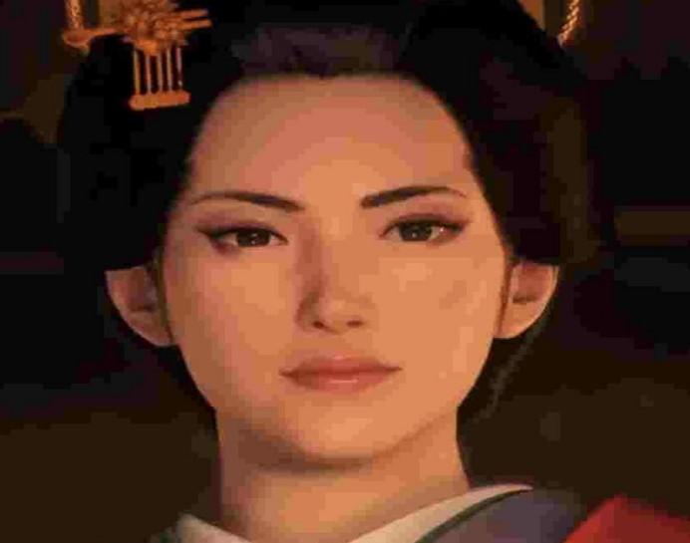

Input-output (human face)
Input
Output

Slide 11


Input-output (text)

Slide 12


Input-output (webpages)

Slide 13
Technologies Used
Python (Programming Language ):Used as the primary programming language for writing the image processing code.
OpenCV (Open Source Computer Vision Library : cv2 module: Used extensively for image loading, image processing operations , and image display
Operating System APIs: Utilized for file handling, such as reading images from a specified file path and saving processed images to a specified output path.

Slide 14
Conclusion
The image processing project utilizing OpenCV demonstrates a systematic approach to enhancing image quality through sharpening and noise reduction techniques.
By leveraging advanced algorithms and libraries, the project achieves significant improvements in visual clarity and fidelity.
In conclusion, the project serves as a robust foundation for implementing effective image enhancement techniques using OpenCV and Python. It underscores the importance of systematic approach in image processing tasks, offering tools and methodologies that can be expanded upon for more sophisticated applications in computer vision and beyond.

